Slide 1

STROKE DETECTION ML MODEL
By Prossy Nansubuga
Date: 07/06/2024

Slide 2
Introduction
Overview:
Project Objective:
Predict the likelihood of stroke occurrences in patients using machine learning classification models.
Leverage data science techniques to build, evaluate, and optimize models.
Assist healthcare providers in identifying high-risk individuals.
Potentially save lives through early intervention.

Slide 3
Business and Data Understanding
Problem Definition
Identifying the Need for Predicting Stroke Occurrences
Stroke as a Major Health Concern:
Strokes are a leading cause of death and disability worldwide.
According to the World Health Organization (WHO), stroke is the second leading cause of death globally and the third leading cause of disability.
The sudden onset and severe impact of strokes make them a critical area for medical research and intervention.
Early prediction and prevention are vital in reducing the burden on healthcare systems and improving patient outcomes.

Slide 4
Challenges in Current Healthcare Practices:
Traditionally, stroke prediction relies heavily on clinical judgment and manual assessment of risk factors.
This approach can be subjective and inconsistent, leading to missed opportunities for early intervention.
High-risk individuals often remain undetected until a stroke occurs, resulting in emergency treatment rather than preventive care.
This reactive approach increases healthcare costs and adversely affects patient quality of life.

Slide 5
Advancements in Data Science and Machine Learning:
The growing availability of healthcare data, coupled with advances in data science and machine learning, provides an opportunity to develop predictive models that can identify individuals at high risk of stroke more accurately and efficiently.

Slide 6
Understanding the Impact of Early Detection on Patient Outcomes
Reduced Mortality Rates:
Early detection allows for prompt medical attention and the administration of clot-busting drugs or surgical interventions in cases of ischemic stroke.
These treatments are most effective when administered within a critical time window after stroke onset.
Cost-Effective Healthcare:
Implementing predictive models in clinical practice can help allocate healthcare resources more efficiently, focusing on high-risk individuals who would benefit most from preventive care.
Data-Driven Decision Making in Healthcare:
Integrating predictive models into healthcare systems promotes data-driven decision-making, enabling personalized and targeted care for patients.
This approach aligns with the broader trend towards precision medicine, where treatments and interventions are tailored to individual patient profiles.
Data-driven insights can also inform public health strategies and policies aimed at reducing stroke incidence and improving population health.

Slide 7
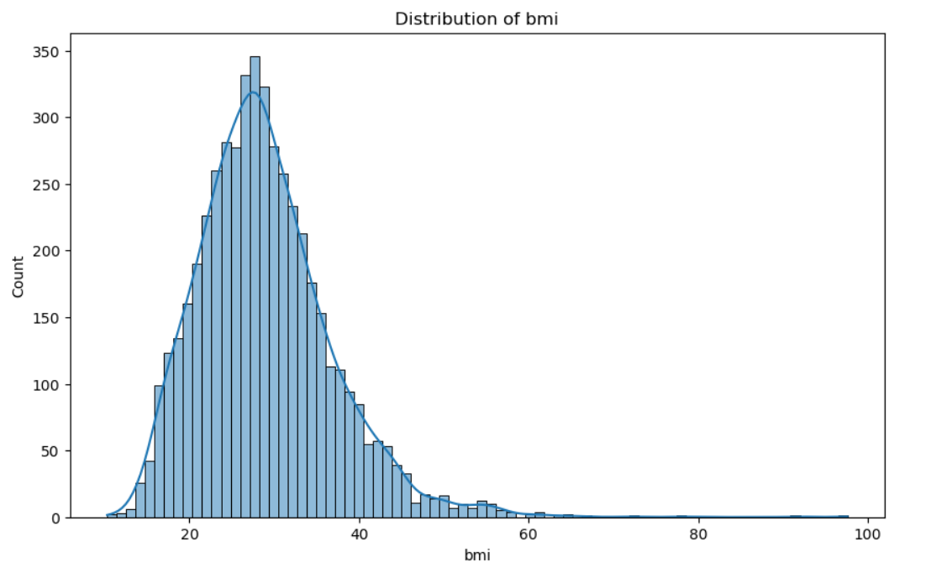
Exploratory Data Analysis
Key Findings:

Slide 8
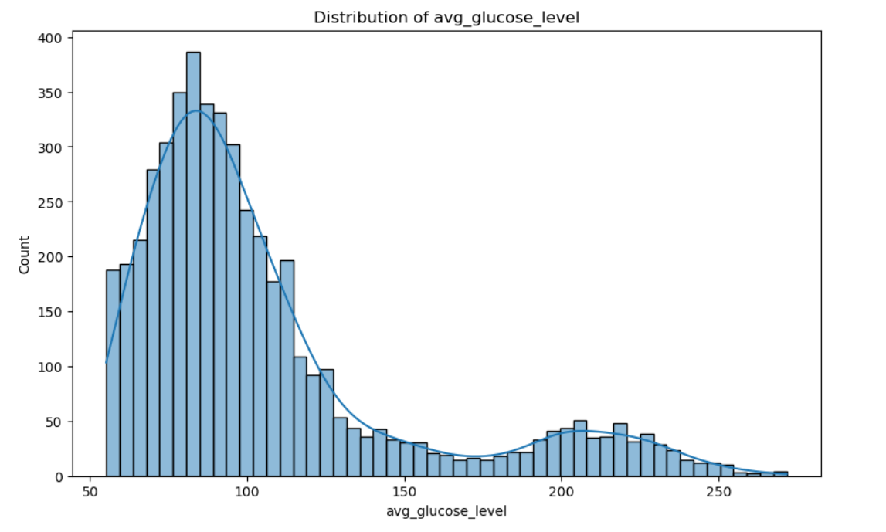
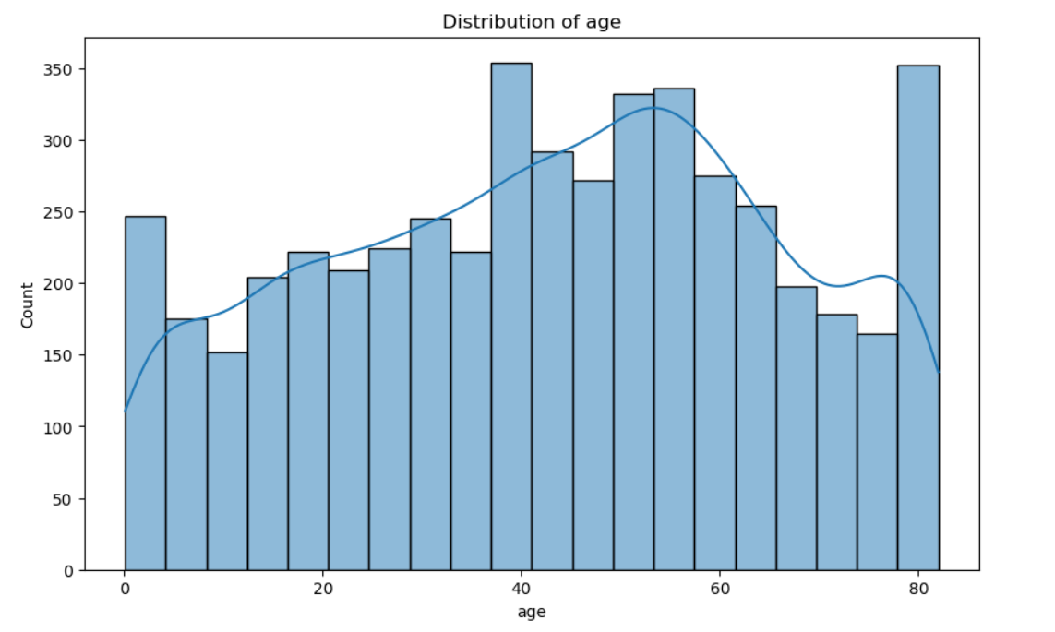

Slide 9
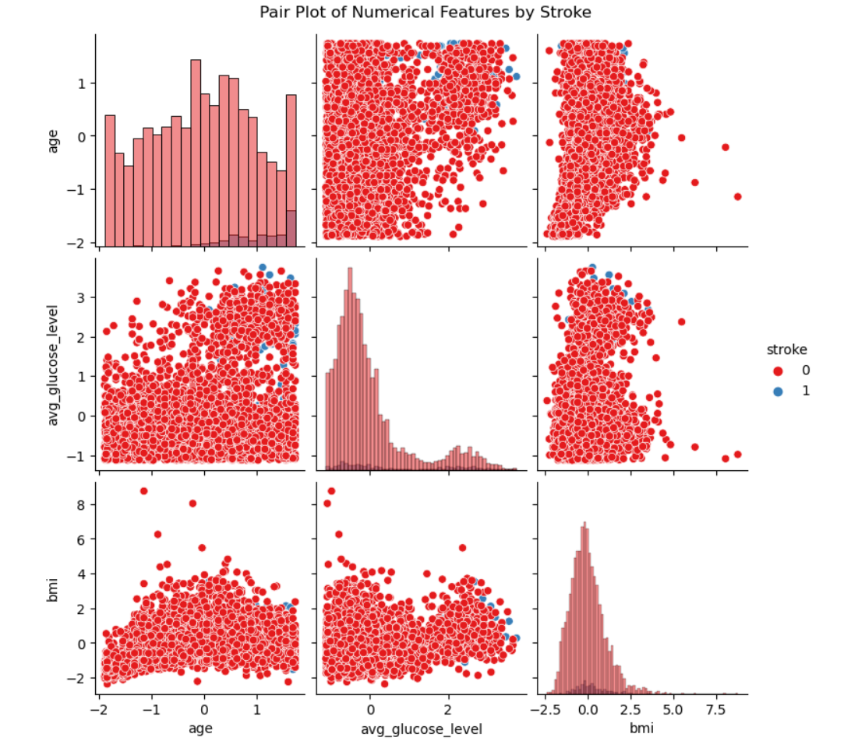
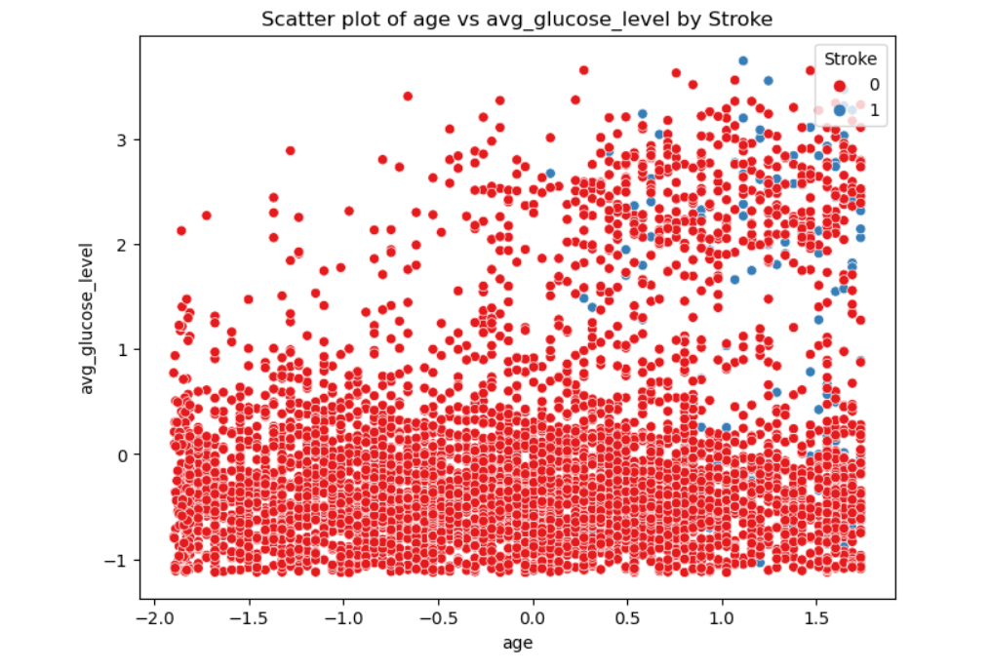

Slide 10
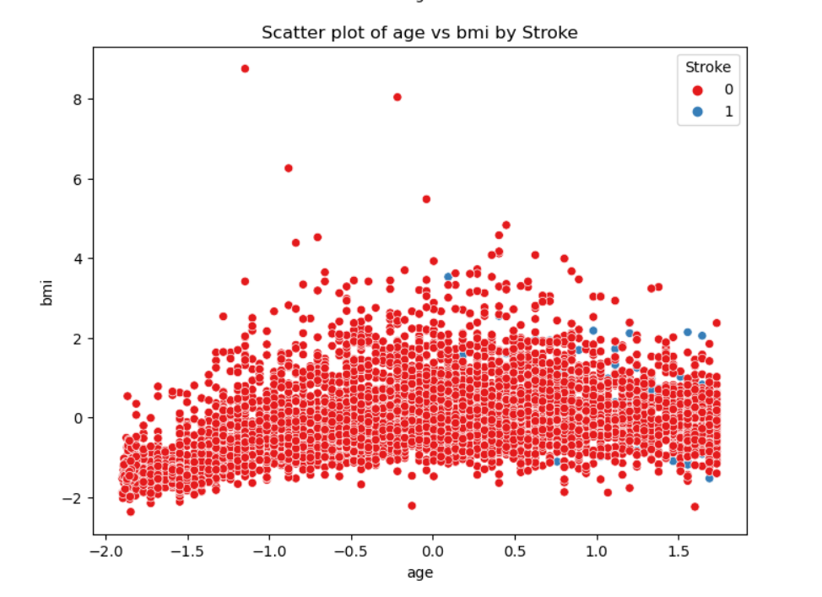
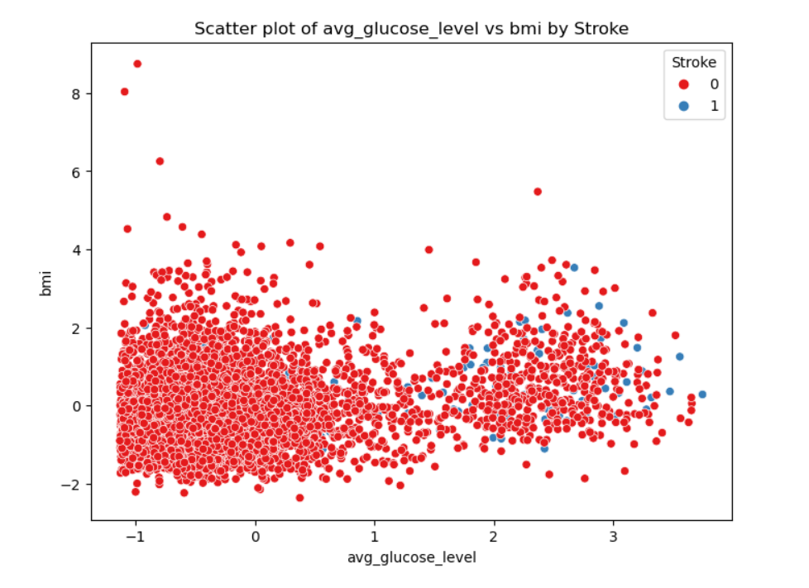

Slide 11
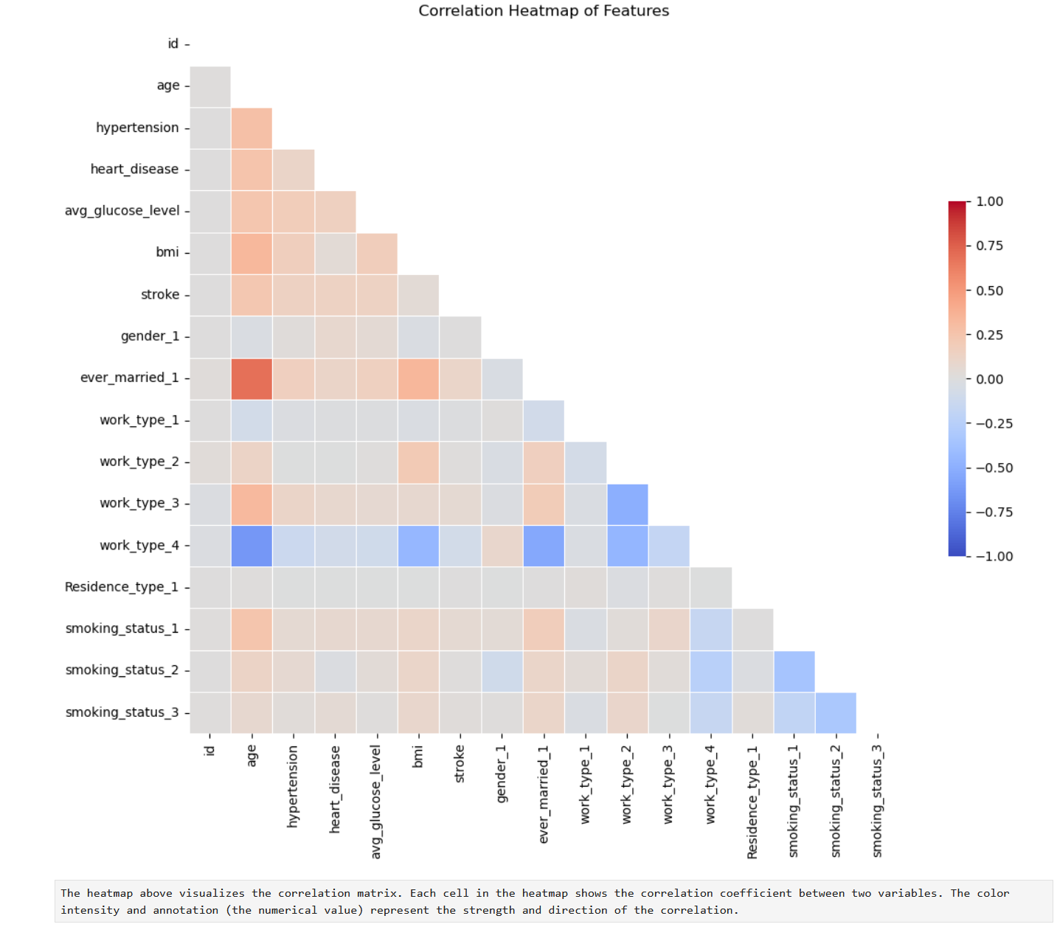
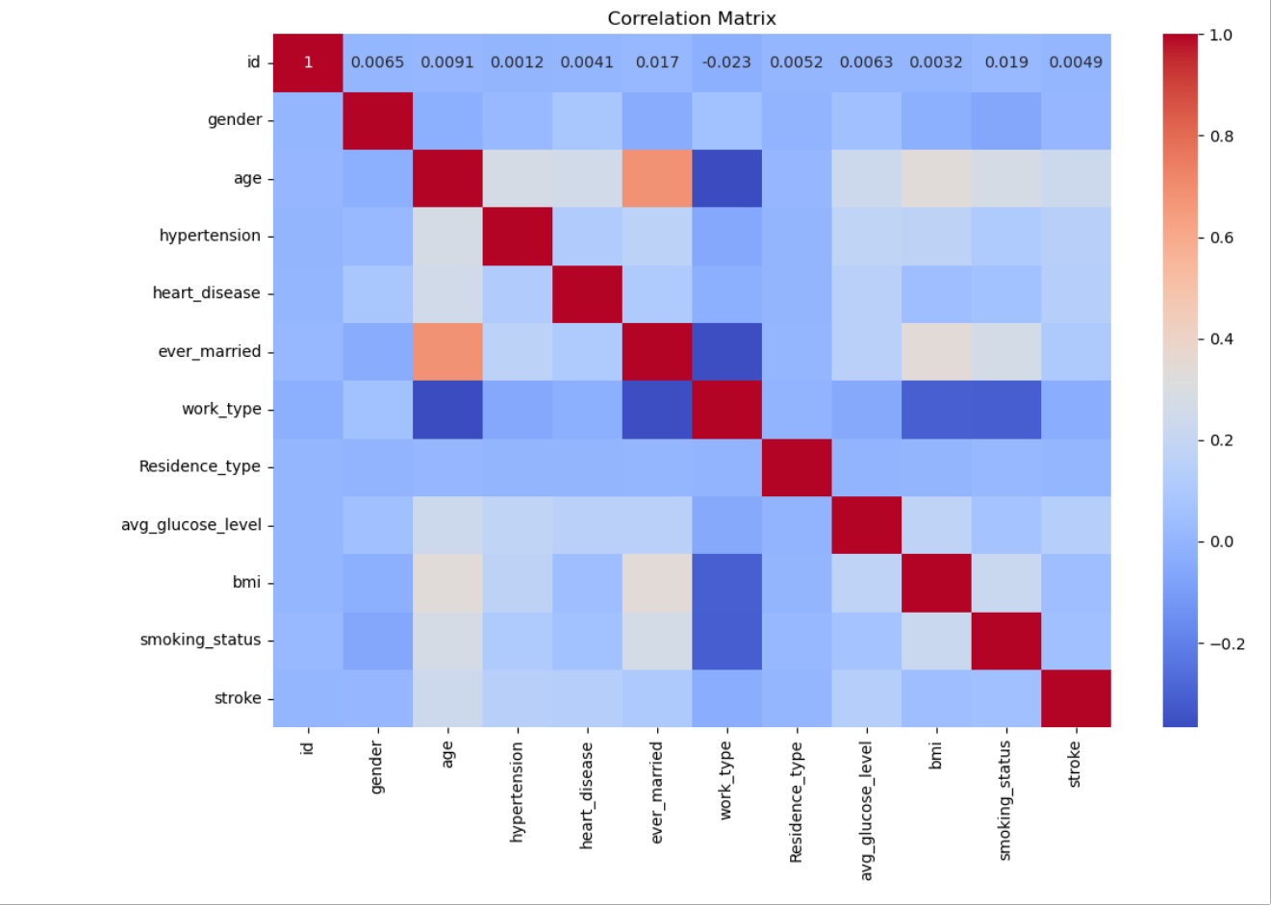

Slide 12
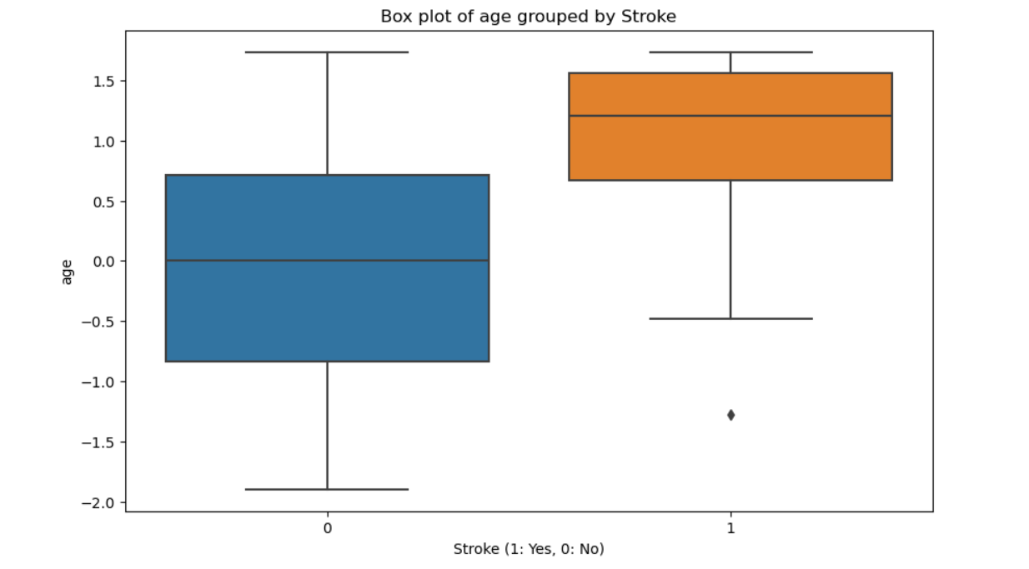
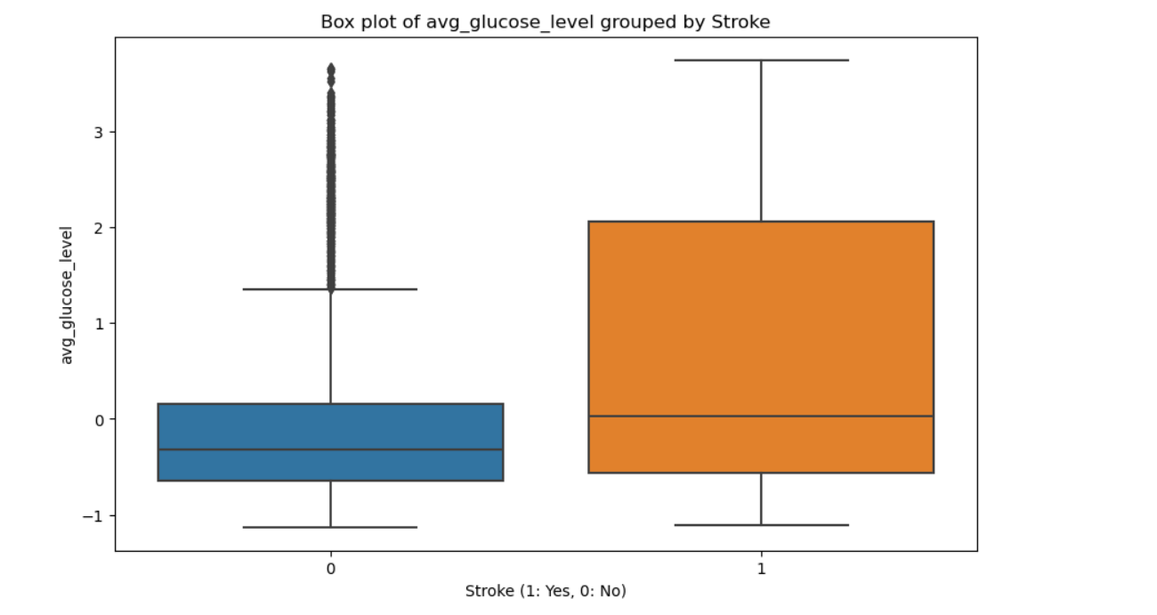
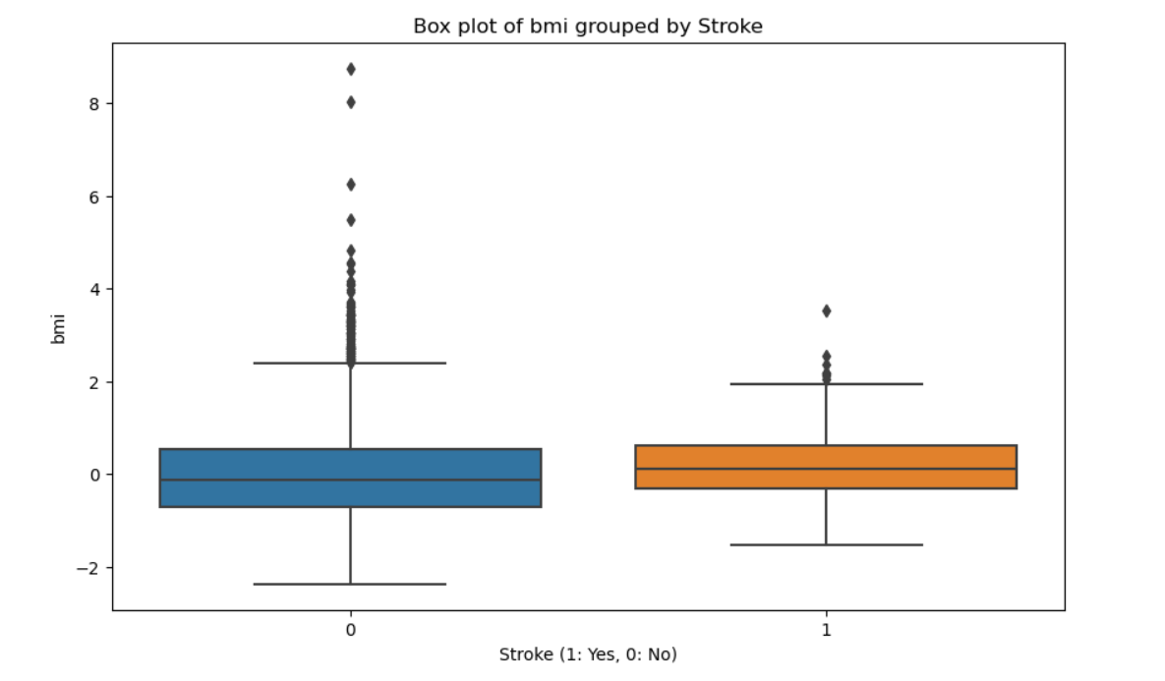

Slide 13
Key Features: Factors that are most influential in predicting stroke
Age: Older age is a significant predictor of stroke risk.
Hypertension: High blood pressure is strongly associated with increased stroke risk.
Heart Disease: Presence of heart disease elevates the likelihood of stroke.
Average Glucose Level: Higher glucose levels can indicate diabetes, which is a risk factor for stroke.
BMI: Both underweight and obesity can influence stroke risk.
Smoking Status: Smoking significantly increases the risk of stroke.
Marital Status: Being married might influence lifestyle factors related to stroke risk.
Work Type: Certain occupations may be linked with stress levels and lifestyle choices affecting stroke risk.
Residence Type: Urban vs. rural living can impact healthcare access and lifestyle.

Slide 14
Machine Learning Models Used
Logistic Regression:
A statistical model that predicts the probability of a binary outcome based on one or more predictor variables.
Random Forest:
An ensemble learning method that constructs multiple decision trees and combines their outputs to improve accuracy and reduce overfitting.
Gradient Boosting:
An ensemble technique that builds trees sequentially, with each tree trying to correct the errors of the previous one to improve model performance.
Decision Trees:
These are a non-linear classification algorithm that splits the data into branches based on feature values. Each internal node represents a feature, each branch represents a decision rule, and each leaf node represents the outcome.

Slide 15
Metrics Used for Evaluation
Accuracy:
The proportion of true results (both true positives and true negatives) among the total number of cases examined.
Precision:
The ratio of true positive predictions to the total number of positive predictions, indicating the accuracy of the positive predictions.
Recall:
The ratio of true positive predictions to the total number of actual positive cases, indicating the model's ability to identify positive cases.
F1 Score:
The harmonic mean of precision and recall, providing a single metric that balances both concerns.
ROC AUC Score:
The area under the Receiver Operating Characteristic curve, which plots the true positive rate against the false positive rate, measuring the model's ability to distinguish between classes.

Slide 16
Model Performance
Decision Tree Model
Accuracy: 91.8%: The model correctly predicted stroke occurrences 91.8% of the time.
Precision for Stroke Class (1): 0.085 :The proportion of true stroke cases among the predicted stroke cases is quite low, indicating a high false positive rate.
Recall for Stroke Class (1): 0.095: The model detected 9.5% of the actual stroke cases, suggesting many true stroke cases were missed.
F1 Score: 0.089: The harmonic mean of precision and recall, indicating a balance of 8.9%.
ROC AUC Score: 0.525: The model's ability to distinguish between stroke and non-stroke cases is only slightly better than random guessing.

Slide 17
Model Performance
Random Forest Model Summary
Accuracy: 95.7% :The model correctly predicted stroke occurrences 95.7% of the time.
Precision, Recall, F1 Score for Stroke Class (1): 0.0: The model did not correctly identify any stroke cases.
ROC AUC Score: 0.5 :The model's predictions are no better than random guessing.
Confusion Matrix:
True Negatives: 940
False Positives: 0
False Negatives: 42
True Positives: 0
Key Insights:
Despite the high accuracy, the tuned Random Forest model's performance on detecting stroke cases is poor, similar to the Logistic Regression and Decision Tree models. This is likely due to the dataset's imbalance, where the majority class dominates the predictions, leading to misleadingly high accuracy.

Slide 18
Model Performance
Logistic Regression Model Summary
Accuracy: 95.7%
The model correctly predicted stroke occurrences 95.7% of the time.
Precision for Stroke Class (1): 0.0
The model did not correctly identify any stroke cases.
Recall for Stroke Class (1): 0.0
The model failed to detect any actual stroke cases.
F1 Score: 0.0
The harmonic mean of precision and recall, indicating no balance between precision and recall for stroke cases.
ROC AUC Score: 0.5
The model's ability to distinguish between stroke and non-stroke cases is no better than random guessing.
Confusion Matrix:
True Negatives: 940
False Positives: 0
False Negatives: 42
True Positives: 0

Slide 19
Model Performance
Gradient Boosting Model Summary
Accuracy: 95.3% : The model correctly predicted stroke occurrences 95.3% of the time.
Precision for Stroke Class (1): 0.167 : When the model predicts a stroke, it is correct 16.7% of the time.
Recall for Stroke Class (1): 0.024 : The model identified only 2.4% of the actual stroke cases.
F1 Score: 0.042 : The harmonic mean of precision and recall, indicating a balance of 4.2%.
ROC AUC Score: 0.509 : The model's ability to distinguish between stroke and non-stroke cases is only slightly better than random guessing.
Confusion Matrix:
True Negatives: 935
False Positives: 5
False Negatives: 41
True Positives: 1
Key Insights:
The Gradient Boosting model performs slightly better than the tuned Random Forest model in terms of precision, but it still struggles with low recall and F1 score for stroke cases. The ROC AUC score indicates marginal improvement over random guessing. This suggests that while the Gradient Boosting model has some potential, it still requires further tuning or additional data to improve its effectiveness in stroke prediction.

Slide 20
Recommendations
Identifying patients at high risk of stroke early can help us prevent strokes before they occur.
Our analysis provides insights into which factors contribute most to stroke risk, such as hypertension and age.

Slide 21
Next Steps
We can further improve our models by collecting more data and refining our algorithms.
Implementing these models in clinical settings could help doctors identify high-risk patients.

Slide 22
Thank you.
We are happy to answer any questions you may have.
Thank you for your attention and interest in our project!

